Slide 1
Business Correspondence
Select the most appropriate format for writing a specific work-related text
(i.e., instructions, directions, letters, memos, e-mails, reports).

Slide 2
Types of Business Correspondence
When you become employed you will need to determine which type of communication you should use in different situations.
Examples:
  When is writing a memo appropriate?
  Should I write a formal letter?
  Are instructions necessary?
  Is an e-mail proper?

Slide 3

Instructions
a message describing how something is to be done
Think of these as orders, commands, advice, or directives.

Slide 4


Letters
Business letters are formal messages following specific formats. They may be addressed to a particular person or organization. Most of the time business letters are sent outside of your company.

Slide 5


Memos
A memo is a document sent within a company. It is presented in short form, highlighting certain aspects.

Slide 6

E-mail
An e-mail is a communication sent from one computer to another, usually via a network. It is the least formal method of written communication within a company.

Slide 7


So, when should I write
  a business letter,
  a memo,
  or an email?

Slide 8
Business Letters
  most formal
  usually sent to someone from a different company than yours, or a different school, etc.

Slide 9
Memos
  less formal than letters, yet more formal than e-mails
  often filed as business correspondence
  use short sentences, less formal language, and bullet points to convey important information
  contain a header that tells who it is from, who it is to, the date, and the subject.

Slide 10
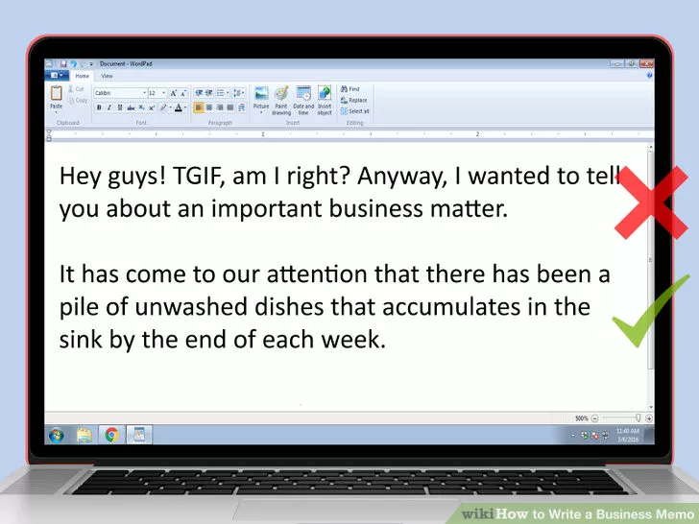

Slide 11
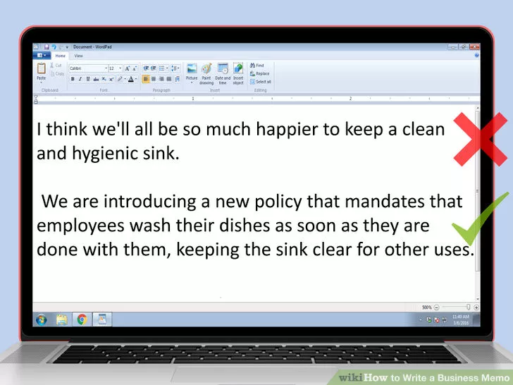

Slide 12
Your Name Your Address Your Town, Your State Zip Code/Postal Code
Memo
To: Name(s) of recipients From: Name of sender Date: Month, day, year
Re: Update on the T-12 Phase Three testing As we enter Phase Four of the T-12 testing, I wanted to provide a progress overview of the Phase Three testing. The body of the memo might include two-four paragraphs outlining the purpose of the memo. If this is a longer memo, each paragraph will have a subhead to help guide the reader through the document. Finally, the writer includes a summary paragraph, which features bullets highlighting the main points of each previous paragraph, and concludes the memo with a stated action required by the reader or writer.

Slide 13
Since it is record of facts & decisions it can be used in future to establish accountability
It gives time to the receiver of communication to deliberate upon it & react
Printed memo forms are used
From____________ Subject________________
To ______________ Date________________
Or it can also be
To ___________________Date___________________
From_____________
Subject_________________
No Dear Sir, or so on
No Yours Sincerely, and so on

Slide 14
Memo
To : Lab Personnel
From: Sushil Kumar
Subject: Final test report requirements
Beginning Monday ,December 19,all our final test reports must indicate –
Test results
Dimension in proper order
The distribution list
Write the report immediately after the test
Be sure all terms are spelled correctly
Complete formulas

Slide 15
Office Circular
The circular is in the form of a letter addressed to all office to all branches/departments
Is drafted in such a way that the information is useful and understandable
Purpose is to circulate information to the entire organization/department
Inviting office staff to a party/installation of card punching machine in the office

Slide 16
ABC Limited
New Delhi
Circular number HR/09/2008/5 Date 06-09-2008
To all the employees
A four –hour computer –training program is arranged for all the employees on
25-09-2008,Sunday,in the office premises. The program will start at 10 A.M .
All the employees are required to attend the program .
Sd/-
Rajesh Sethi
Human Resource manager

Slide 17
E-mails
  less formal - written in a conversational style
  sent to your work colleagues or fellow students/professors from the same school

Slide 18


Reports
a written document describing the findings, results, or conclusions of some individual or group

Slide 19

Sample Test Questions

Slide 20
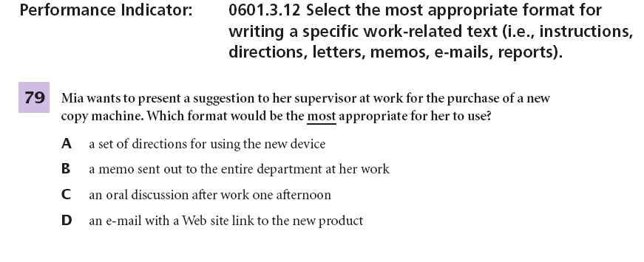

Slide 21
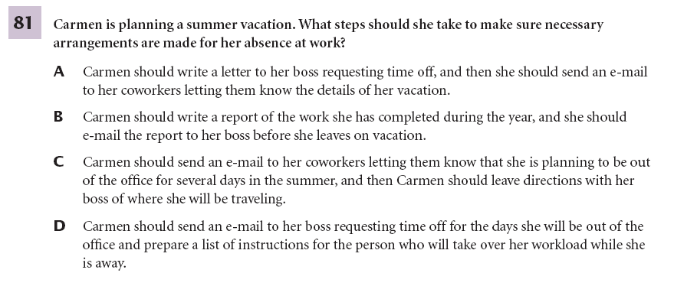

Slide 22
Business proposals
A business proposal can often make or break your chances of securing a new client.
Write a poor one, and you might lose out—even if you’re offering the best service out there.
A business proposal is perhaps one of the most critical documents you need to learn how to write

Slide 23
Meaning
A business proposal is a written document that offers a particular product or service to a potential buyer or client.
A business proposal is created to offer a product or service to a buyer or client. On the other hand, a business plan is a “formal statement of a set of business goals” and how these would be achieved. The latter is only part of what is included in a business proposal.
A request by a business or individual to complete a specific job or project; to supply a service; or in some instances to be the vendor of a certain product.

Slide 24
3 Ps of a Winning Business Proposal
The secret behind writing a winning business proposal and one that will just be set aside is the presence of what I call the
3 Ps: problem statement,
proposed solution,
pricing information.

Slide 25
Example of problem Statement
Here’s an example of a well-written problem statement of a business proposal:
With the presence of social media in today’s advancing world, Puffin Media Inc. hesitated to make the leap from traditional marketing to social media marketing.
Their marketing tactics seem to be losing effectiveness and the company feels as if they are missing out on a large segment of their market. In addition, their competition has began acquiring the majority of the business in the market and have brought Puffin Media’s growing revenues to a halt.

Slide 26
Problem solution
Here’s an example:
The solution that is recommended for Puffin Media Inc. is to deploy their company on all of the major social media channels; however, there is a major difference in creating social media platforms versus creating a brand you can promote on those platforms.
A marketing campaign must be created utilizing these media channels and creating immediate engagement with your audience. In order for this to be successful, you know how to make sales. Initially, acquire some fans, followers, subscribers, and connections and invite them to join you in particular discussion or attend a specific event.
The purpose of this is not only to promote Puffin Media Inc, but also to solicit feedback from the target audience.

Slide 27
Pricing information
How to write this part greatly depends on the solution or solutions you included in the previous segment.

Slide 28
Steps
Do Your Research
Put Yourself in their Shoes
Why You?
Writing that Business Proposal
A Final Word

Slide 29
Types
Research proposal
Business proposal

Slide 30
Parts of business proposals
TITLE PAGE – name of the company , name of the individual , date of submission
EXECUTIVE SUMMARY, Abstract, SYNOPSIS
Brief proposal should have an executive summary. Because you will be competing with other for the same opportunity, some evaluator will initially read only the executive summary seeking to gain a quick overview.

Slide 31
DRAFT CONTRACT
A draft contract allows the receiver to offer a counter offer.
Table Of Contents
Brief proposal usually do not require a table of content. Long proposal do require one as well as a list of table, figure and illustration.

Slide 32
INTRODUCTION
The proposal introduction section includes,
a) Purpose
B) Problem
C) Scope

Slide 33
BACKGROUND
• Previous work completed on identical or related project.
• Possibly, literature reviews on the subject, particularly your evaluation of them.
• Statements showing how your proposal will build on the already completed projects and research.

Slide 34
PROCEDURES
In procedure, you give brief state, without exaggeration, how you will meet the requirement of your reader. A good way to review your proposal they will be different in each situation.

Slide 35
EQUIPMENT AND FACILITIES
It shows that you have thought deeply to realize what facilities will be needed. If your proposal is for your company's bid on an enormous construction job, probably several departments will cooperate with you in presenting needed facts and figures.

Slide 36
PERSONNEL
If you did not include brief information of individuals involved in the project in the introduction then give full information about the proposal and also the percentage of time that personal will devote to t6he project.
BUDGET
Organization requesting proposal frequently specify how the budget should be presented. Read such specifications carefully. Not all groups allow the same costs.
APPENDIXES
The last section includes; visuals such as maps or groups and some other pertinent letter of support and endorsement added. Thank Writer

Slide 37
All the rules of writing, including the seven C’s pertain to proposal writing

